Slide 1
Analyzing the Influence of Actor Names on Movie Posters
Arundhati Kolahal, Shiv Nag, Shreya Lodha, Tharfeed Ahmed Unus, Yash Kothari
Group 13
Notes:
Hello Everyone, Our topic is Analyzing the Influence of Actor Names

Slide 2
01
Introduction
Notes:
"Good [morning everyone. Today, we’ll be presenting our study on the influence of actor names on horror movie posters and how they shape audience perceptions. Our research team consists of [names], and we are excited to share our findings with you. Let’s begin by understanding the background of our study."

Slide 3
Background
Horror movie posters use visuals and text to shape audience perception
Familiar actor names may influence how scary a poster feels
We aim to explore how actor names impact fear perception
Notes:
Quick question—how many of you love horror movies? And how many of you get scared just by looking at a creepy movie poster? Now, imagine seeing a horror movie poster, but instead of just eerie visuals, you spot the name of your favorite actor. Would that make the movie seem less scary?

Slide 4
Research Question
How does the presence of actor names on movie posters affect the perception of scariness of the movie?
Notes:
Does adding actor names to horror movie posters change how scary people think the movie is?
Sounds simple, right? But there’s more to it than meets the eye, and we wanted to put this idea to the test!"

Slide 5
Hypothesis
The presence of actor names on movie posters will decrease the perceived scariness of the movie, as compared to the actor names being absent from the movie poster.
H0: There is no effect of including actor names on horror movie posters
Ha: There is an effect of including actor names on horror movie posters
Notes:
We structured this using two hypotheses:
H₀ (Null Hypothesis): Actor names have no effect on how scary a movie poster seems.
Hₐ (Alternative Hypothesis): Actor names do change how scary people think the movie is.
The goal? See if we could scare our null hypothesis away and prove that actor names actually influence audience perception!

Slide 6
02
Experiment Methodology

Slide 7
Experimental Design
Selected five horror movie posters—Companion, Midsommar, Rings, Saw, Unfriended—as the control group (no actor names)
Created a treatment group by editing the posters to include starring actors' names
Added covariates such as age, gender, and social media usage

Slide 8


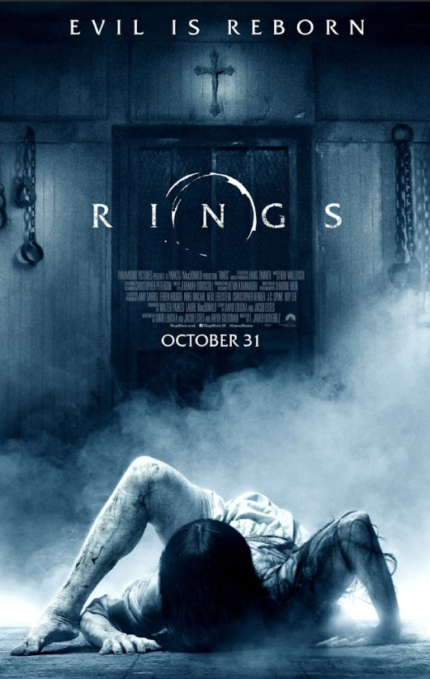
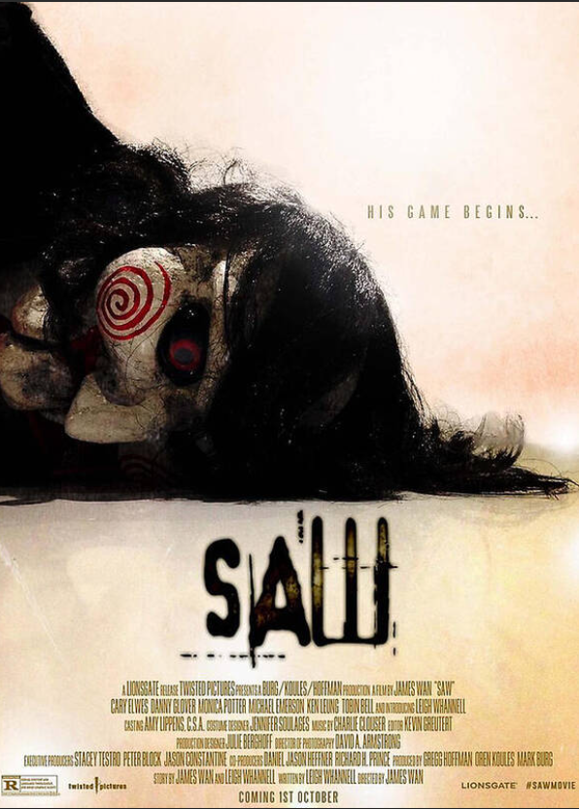
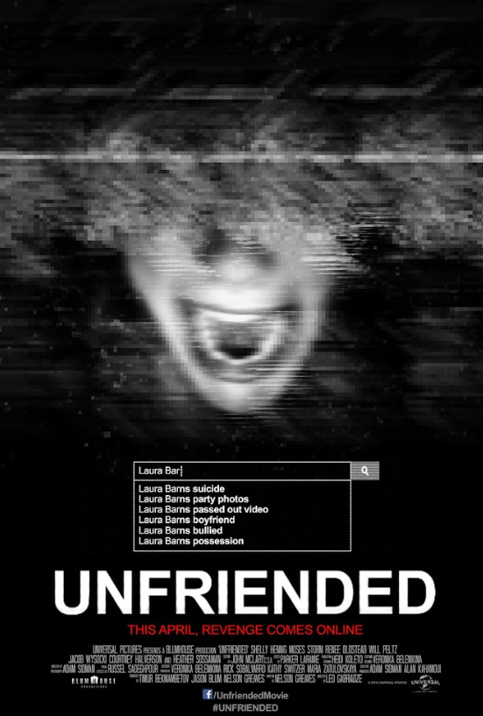


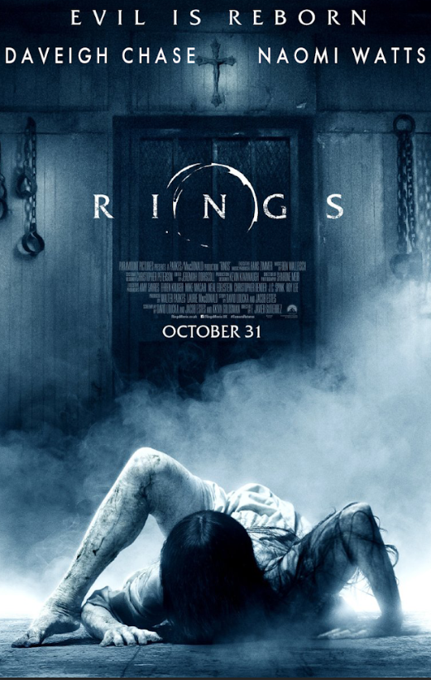
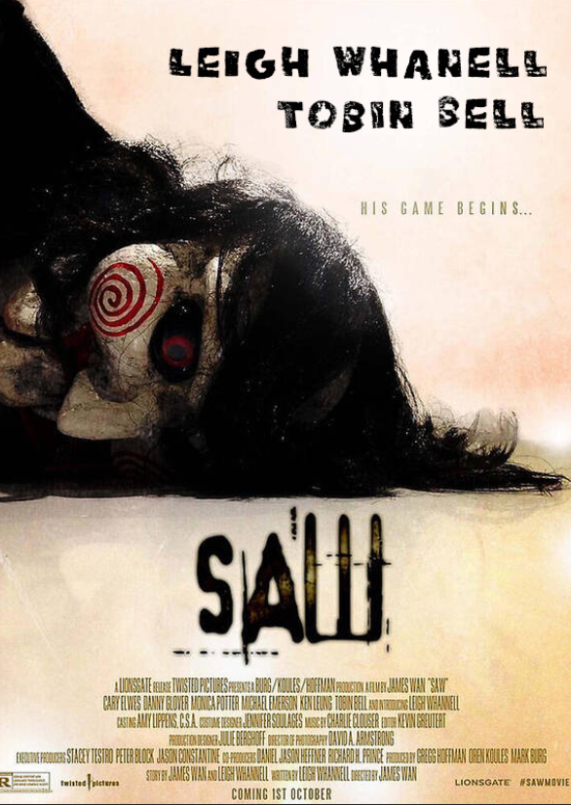
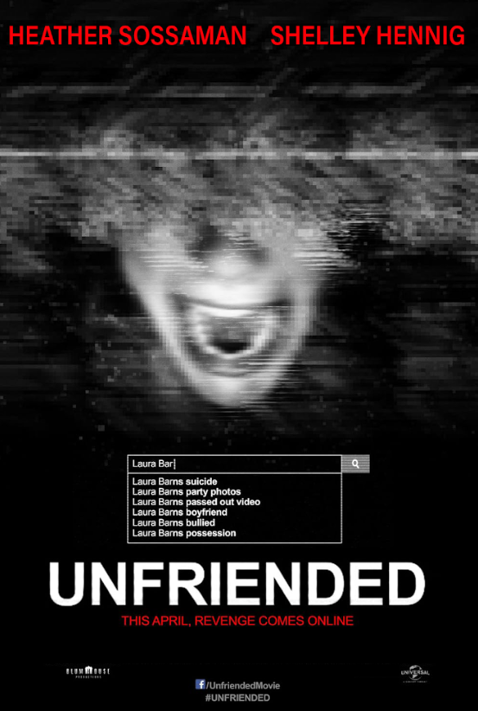
Control:
Treatment:

Slide 10
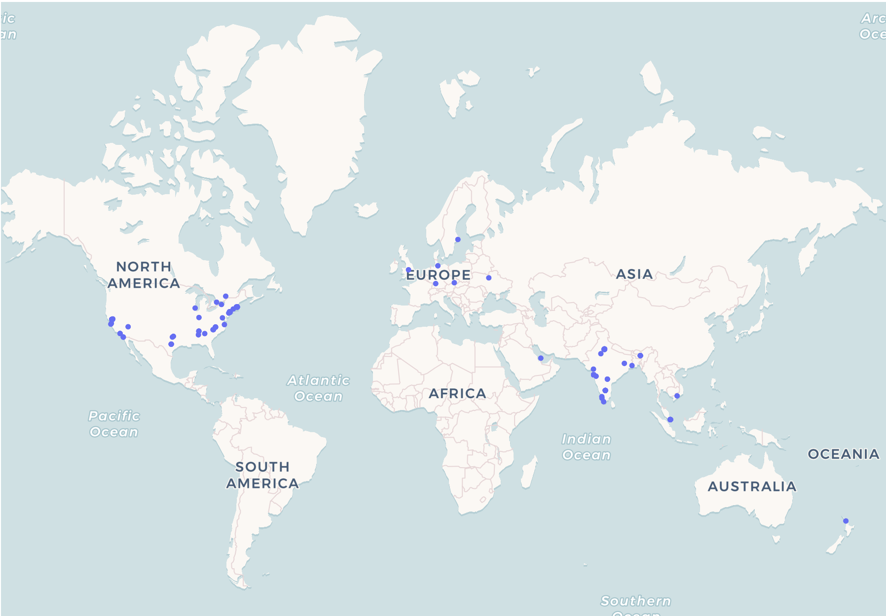
Data Collection
Randomized at the movie poster level using a confidential Qualtrics survey
Each participant saw a unique mix of control (no actor names) and treatment (actor names added) posters
Randomization prevented selection bias and prevented spillovers across participants

Slide 11
03
Analysis & Results

Slide 12
Statistical Power
Experimental Level | n_obs Needed | n_obs Received
Overall Experiment | 638 | 835
Total per Group (Treatment & Control) | 319 | 417
Total per Poster per Group | 64 | 83
Number of Respondents | 128 | 167
Notes:
The team calculated a preliminary power analysis to see how many observations would be necessary for them to achieve statistical power in the experiment and received the following outcome,

Slide 13
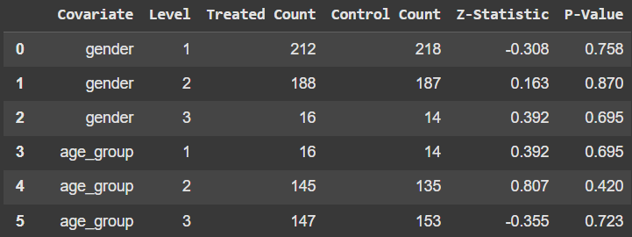
Proportions Test
Goal: Confirm balance between treatment and control groups
Tested key covariates (gender, age, social media habits); all p-values > 0.05 (lowest = 0.19), therefore we fail to reject H₀
Results: groups were well-balanced, ensuring outcome differences are due to treatment, not pre-existing factors
Notes:
Note: this table is just the first 5 lines We conducted a proportions test to ensure the treatment and control groups were balanced before the treatment began. This check covered key covariates — gender, age group, social media usage, and social media preference. The null hypothesis (H₀) assumed that the proportion of each covariate level was the same across both groups. The results showed that all p-values exceeded 0.05 (lowest p = 0.19), meaning we fail to reject the null hypothesis.
This confirms that the treatment and control groups are well-balanced, so any differences in outcomes can be more confidently attributed to the treatment itself, rather than pre-existing differences between the groups.

Slide 14
Significant Difference Check
Conducted a two-sample t-test to measure the effect of actor names on perceived scariness and watch likelihood
Results showed minimal difference, with high p-values
Failed to reject H₀, indicating no significant impact of actor names on perception
Outcome | t-Stat | p-value
Perceived Scariness | 0.097 | 0.923
Likeliness to Watch | 0.322 | 0.748
Notes:
To assess whether the treatment had a statistically significant effect on participants’ responses, we conducted a two-sample t-test. Our primary outcome was “Scary,” measuring how frightening participants found the poster, and our secondary outcome was “Likely,” measuring how likely they were to watch the movie. We tested the null hypothesis (H₀) that there is no difference in average scores between the treated and control groups.
The results showed t-statistics of 0.097 for “Scary” and 0.322 for “Likely,” both very close to zero, indicating minimal difference between the groups. This is further supported by p-values of 0.923 and 0.748, both well above 0.05. Therefore, we fail to reject the null hypothesis, concluding that the treatment had no statistically significant effect on either outcome.

Slide 15
Average Treatment Effects (ATE)
The average ATE for the outcome variable “Scary” is 0.018 and the average ATE for “Likely” is 0.064 and the p-values are higher than 0.05
The treatment had no statistically significant effect on either outcome - perceived scariness, likelihood to watch the movie
Demographic and behavioral factors played a stronger role in shaping both outcomes
Gender-specific and age specific differences in reactions emerged for certain posters amongst certain subgroups but the effects seem to be driven by who the participant is
Notes:
1️⃣ The treatment (poster shown) had no statistically significant effect on either perceived scariness or likelihood to watch, both overall and at the poster level (p > 0.1 across all cases). This suggests that the posters themselves did not meaningfully influence participants’ reactions.
2️⃣ Demographic and behavioral factors — especially age group, gender, and social media usage — played a much stronger role in shaping both outcomes (particularly for likelihood to watch), highlighting the importance of understanding audience characteristics over creative tweaks.
3️⃣ Gender-specific and age-specific differences in reactions emerged for certain posters (e.g., Unfriended for males, Companion for females), suggesting that some creative elements may resonate differently across subgroups — but these effects were driven by who the participant is, not the poster alone.

Slide 16
Conditional Average Treatment Effects (CATE)
Posters had no consistent effect on scariness or likelihood to watch
Age, gender & social media habits shaped both outcomes far more than the posters themselves
Treatment caused certain subgroups to react differently — e.g., males found Unfriended scarier, females found Companion scarier (p < 0.1)
Social media usage boosted interest for younger (18-24) viewers but reduced it for older (55+)
Notes:
1️⃣ The posters themselves had no consistent effect on perceived scariness or likelihood to watch across age groups, genders, or posters.
2️⃣ Who the participant is — especially their age, gender, and social media habits — played a far stronger role in shaping both outcomes.
3️⃣ Certain subgroups reacted differently to specific posters. For example, males found Unfriended scarier (p < 0.1) and females found Companion scarier (p < 0.1), showing that creative elements resonate differently depending on audience characteristics.
4️⃣ Higher social media usage increased likelihood to watch for younger participants (18-24), but reduced likelihood for older participants (55+), highlighting important behavioral patterns for future targeting.

Slide 17
Limitations
The experiment was conducted over only two days, limiting data collection period
Therefore, this may have limited the participant pool
Familiarity with selected movies may have influenced fear perception
Not accounting for participants’ horror movie preferences may have impacted results
Notes:
A larger participant pool could have captured broader perspectives
Using upcoming horror films could have provided a more neutral measure could have provided a more neutral baseline for measuring reactions.

Slide 18
Conclusions
With no significant differences between control and treatment groups, we failed to reject the null hypothesis
Results showed no significant impact of actor name recognition, suggesting that actor names alone do not meaningfully shape audience expectations
Demographic and behavioral factors had a stronger influence on interest to watch than the presence of actor names
Future research could explore implementing strategies identified to combat the limitations of our experiment
Notes:
- Which means that there is no significant difference in the average outcomes between treatment and control groups. Including actor names had no significant difference in the perceived scariness or likelihood to watch.
- We did identify significant results for certain subgroups of our participant population especially when it came to results for our secondary outcome variable - likelihood to watch movie.
- accounting for upcoming movie posters and running the experiment for a longer period of time.

Slide 19
Thank you!

